Slide 1


International Cadmium Association
16th Health and Safety committee meeting
Brussels, June 25th, 2018
10:00 -17:00

Slide 2
Agenda
10.00 Welcome, tour de table and statement of Compliance
10.10 Update on REACh
Results of Cadmium Genotox study
ISES workshop on (bio)monitoring
C.Canoo and N.Lombaert
10:30 Reporting on workplace air monitoring OCdAir-5
M.Gilles
11:00 Coffee break
11:30 Reporting on monitoring of Cd in urine and blood OCdBio-10
M.Gilles
12:15 Lunch
13:00 Amendment to the CMD proposed by the EU Commission: setting a binding OEL for cadmium at 1µg/m³ inhalable? P. de Metz
History of the amendment: SCOEL-IA-WPC/ACSH-COM
Legislative process: Commission-Parliament-Council
Actions undertaken by ICdA
14:30 Coffee break
15:00 Amendment to the CMD: next steps P. de Metz
16:30 Revision of ICdA Guidance (edition 2013)
P. de Metz
16:55 A.o.b.
17:00 End of the meeting

Slide 3
STATEMENT OF COMPLIANCE
The purpose of the meeting is to address, under the applicable confidentiality rules, issues concerning Cadmium and Cadmium compounds producers and importers and more particularly their obligations under the several regulations.
The minutes kept during the meeting will have to reflect all significant matters discussed during the meeting.
No discussions will be held, formally or informally, during specified meeting times or otherwise, involving, directly or indirectly, express or implicit agreements or understandings related to: (a) any company’s price; (b) any company’s terms or conditions of sale; (c) any company’s production or sales levels; (d) any company’s wages or salaries; (e) the division or allocation of customers or geographic markets; or (f) customer or suppliers boycotts; or (g) any disclosure of information which may affect applicable rules on Competition Law.
The International Cadmium Association (ICdA), as a group will make no recommendations of any kind and will not try to reach any agreements or understandings with respect to an individual company’s prices, terms or conditions of sale, production or sales levels, wages, salaries, customers or suppliers.

Slide 4
REACH/ Authorisation: Cd & Cd-compounds (1)
Each year, ECHA (1) adjusts scores of substances and (2) recommends substances from the SVHC-list, the highest ranked first, for being included in Annex XIV of the REACH Regulation (List of Substances Subject to Authorisation).
The system as from this year and ECHA scored also substances recently added to the SVHC-list: Cd(OH)₂ ₍₋₁₈₋₎, CdCO₃ ₍₋₁₉₋₎ and Cd(NO³)₂ ₍₋₁₋₎; usually a year later
  The high score of CdCO₃ resulted from a certain confusion in the information retained from co-registration files not updated since 2010
  Those co-registration files were updated and the information conveyed directly to ECHA; the CdCO₃ score was apparently re-adjusted

Slide 5
REACH/ Authorisation: Cd & Cd-compounds (2)
The 9th draft recommendation has been eventually issued a few days ago for discussion at the MSC meeting of June:
    No Cd-compound was retained in that 9th draft list
    They are now in front line of the scored substances for the 10th list
It is almost certain that a group of Cd-compounds will be proposed next year. (unless a big group of PBT’s is dropped on the list in August)
A second Workshop was organised by the Reach Consortium on preparation of Applications for the Authorization (AfA)
    a.o. discussion on the documented uses in the dossiers of Cd(OH)2, CdO and Cadmium

Slide 6
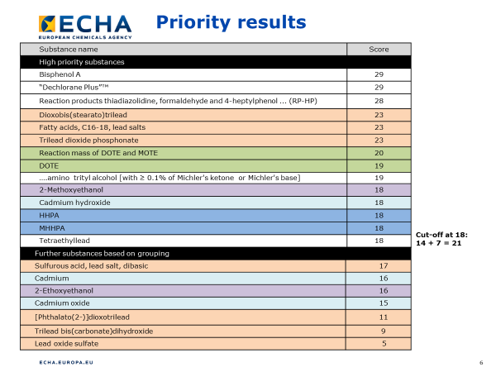
REACH/ Authorisation: Cd & Cd-compounds (3)

Slide 7
Genotoxicity (micronucleus) study (1)
  Aim of the study:
    to analyse the shape of the dose-effect relationship for the genotoxic effects of Cd at low doses in occupational settings
    to test the hypothesis of a threshold dose for the genotoxic effects of Cd
    a secondary hypothesis is that the Cd-U threshold for genotoxic effects is >10 µg/g creatinine, i.e. higher than the current occupational exposure limit (2 µg/g creatinine)

Slide 8
Genotoxicity study (2)
  Time line of the study:
  Blood/urine sampling at 2 cadmium industry sites occurred September/October 2017 (total N= 60 : 38M-22F)
  Micronucleus scoring was finished end March 2018
  Meeting on May 2nd with Ghent University, UCL and REACH Cd consortium: presentation of results
  Universities will work together on a publication for a peer reviewed journal (Q3-Q4 2018)

Slide 9
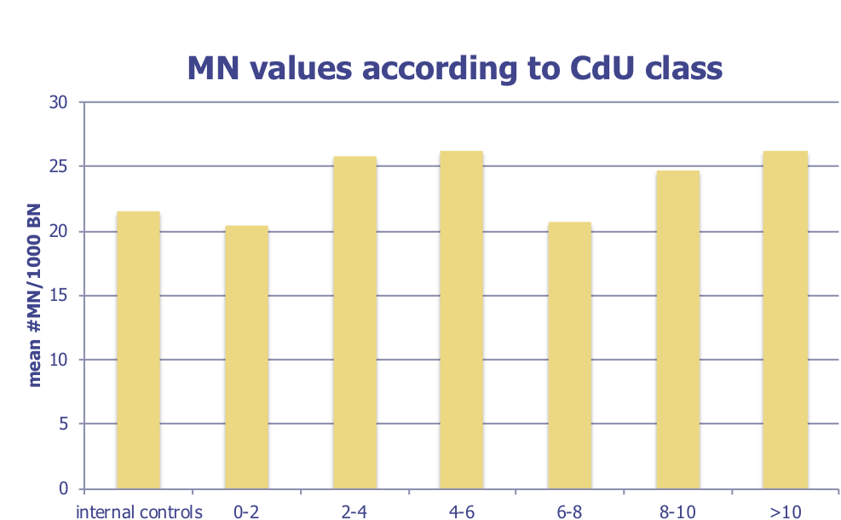
Genotoxicity study: Results (1)
  No increase of micronuclei, even not in the group of the highest exposed workers (>10 µg/g creatinine)
    Proficiency of the test is guaranteed as positive control (radiated samples) showed high MN scores (400-900 MN/1000 scored cells)
Cd-U (µg/g creat)

Slide 10
Genotoxicity study: Results (2)
  Multiple regression analysis for the effect of confounding factors on MN showed:
  No influence of smoking
  No influence of Cd-B, Cd-U
  Influence of gender (F>M)
  Relationship between cadmium in blood (CdS) and frequency of micronuclei in circulating lymphocytes (MN/1000 bn).
For CdS values > 0.15 µg/dl,
the frequency of MN is significantly higher in women (F, red)
than in men (M, green).

Slide 11
Genotoxicity study: Conclusions
  Absence of genotoxic effects in lymphocytes of workers exposed to low levels of cadmium
  The frequency of MN in lymphocytes of workers was related to internal Cd doses to test the hypothesis of a threshold for the genotoxic effects of Cd
  and showed the Cd-U threshold for genotoxic effects is >10 µg/g creatinine, i.e. higher than the current BLV (2 µg/g creatinine)

Slide 12
ICdA participation at ISES Europe 2018
International Society of Exposure Science Europe had its 1st European Exposure Science Strategy Workshop, June 19-20 at the Federal Institute for Occupational Safety and Health (BAuA), Dortmund
https://ises-europe.org
Mission of ISES: “To integrate exposure science into European regulations and industry practice, and to anchor it in academic research and education, in order to foster innovation and to create a safe and sustainable future for humans and the environment”
ICdA presented 2 posters related to:
  ICdA risk management system (→Exposure Assessment Methods & Tools)
  OCdBio Campaign (→ Data Repositories & Analytics)

Slide 13
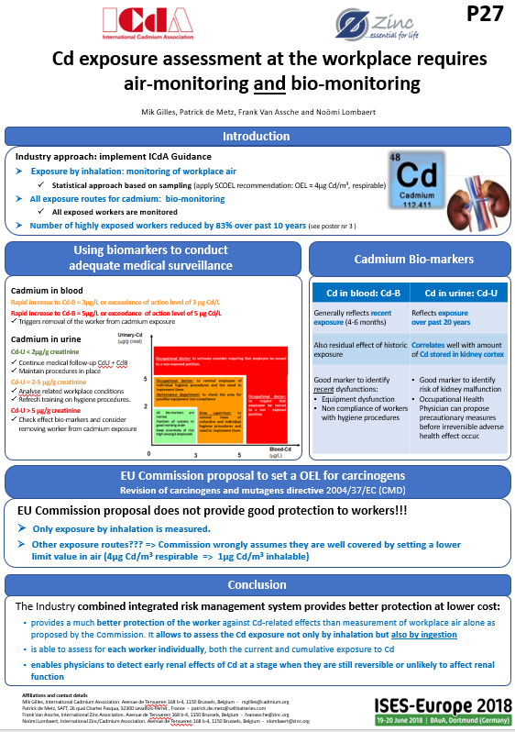

Slide 14
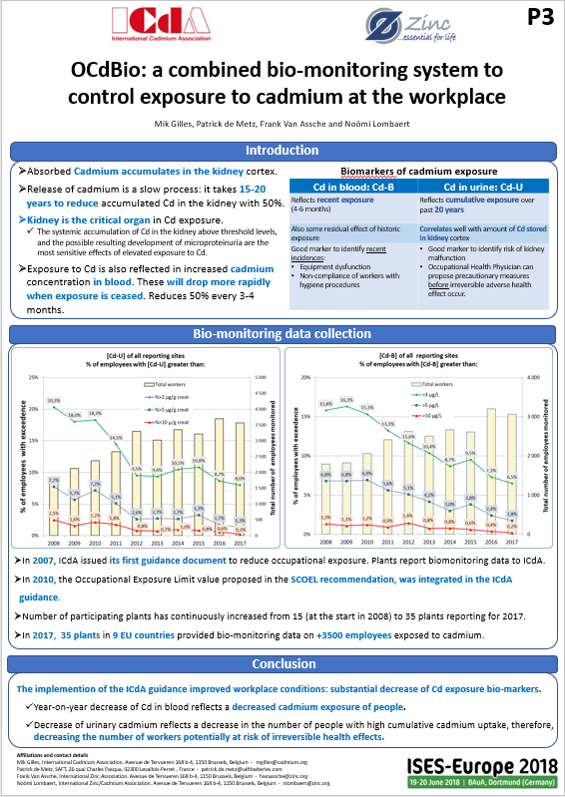

Slide 15
Cadmium Occupational monitoring

Slide 16
OBSERVATORIES:
Monitoring Cd exposure of workers
OCdAIR-5: results, analysis, discussion
  Presentation of reported data from members
  Conclusions
OCdBIO-10: results, analysis, conclusions
  Presentation of reported data from members: CdU, CdB, and post-2000 hires subgroup
  Conclusions
Way forward

Slide 17
OCdAIR-5
Occupational Cadmium Air-monitoring Observatory
Report of 2017 monitoring results

Slide 18
OCdAir
Personal air sampling at the workplace
  Fifth year of data collection
  Sharp increase in response in anticipation of the EU OEL setting
 | 2013 | 2014 | 2015 | 2016 | 2017
Plants | 12 | 22 | 20 | 16 | 30
SEGs | 67 | 142 | 131 | 124 | 162
Workers | 994 | 1548 | 1369 | 1278 | 2249
Sampling quality improved
  More samples for each SEG
  All measures mentioned respirable of inhalable fraction
  Correction for Personal Protection Equipment during sampling

Slide 19
OCdAir
ICdA guidance: Air quality should be under control to assure
< 4µg Cd/m³ respirable air, always and for all workers
  In line with the SCOEL 2010 Recommendation.
  Confirmed in SCOEL 2017 Opinion, provided that biomonitoring is in place and a BLV of 2µg Cd/g creatinine is considered
  But… on request of the EU COM, the SCOEL issued the 2017 Opinion:
  In absence of biomonitoring the OEL should be 1µg/m³ inhalable.
  (= 0,10 à 0,25µg/m³ respirable)

Slide 20
OCdAir Reporting: Geometric mean
“non-conclusive” was added in 2015 for not lognormal distribution of SEG or insufficient samples

Slide 21
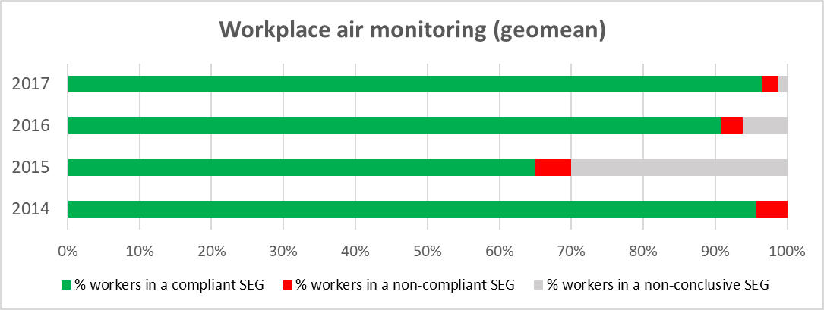
OCdAir Reporting: Summary geo-mean
Geomean (compliance check with 4µg Cd/m³ resp.)
Range [µg/m³] | 2014 | 2015 | 2016 | 2017
% workers in a compliant SEG | 96% | 65% | 91% | 96%
% workers in a non-compliant SEG | 4% | 5% | 3% | 2%
% workers in a non-conclusive SEG | 0% | 30% | 6% | 1%
workers above 0,25µg/m³ (= +/- 1µg/m³ inhalable) |  |  | 66% | 47%
96% is compliant with 4 µg/m³ respirable
But: only 53% is compliant with 1µg/m³ inhalable
Less inconclusive assessments

Slide 22
OCdAir Reporting: 90 percentile
 | - OCd-AIR 3- |  | - OCd-AIR 4- |  | - OCd-AIR 4-
90 percentile | 2015 |  | 2016 |  | 2017
Range [µg/m³] | number of SEGs in this range | Number of workers | number of SEGs in this range | Number of workers | number of SEGs in this range | Number of workers
0 to 0,25 |  |  |  | 137 | 23 | 429
0 to 1.0 | 13 | 267 | 37 | 339 | 63 | 997
1.1 to 2.0 | 9 | 147 | 19 | 439 | 19 | 331
2.1 to 3.0 | 5 | 21 | 16 | 149 | 14 | 291
3.1 to 4.0 | 4 | 48 | 7 | 48 | 4 | 53
4.1 to 5.0 | 2 | 8 | 7 | 54 | 5 | 39
5.1 to 7.0 | 2 | 21 | 3 | 46 | 5 | 17
7.1 to 10.0 | 2 | 49 | 3 | 19 | 5 | 40
>10.1 | 6 | 143 | 7 | 48 | 7 | 40
other non-compliant | 5 | 17
non-conclusive | 83 | 648 | 28 | 309 | 40 | 441
Total number | 131 | 1369 | 127 | 1451 | 162 | 2249

Slide 23
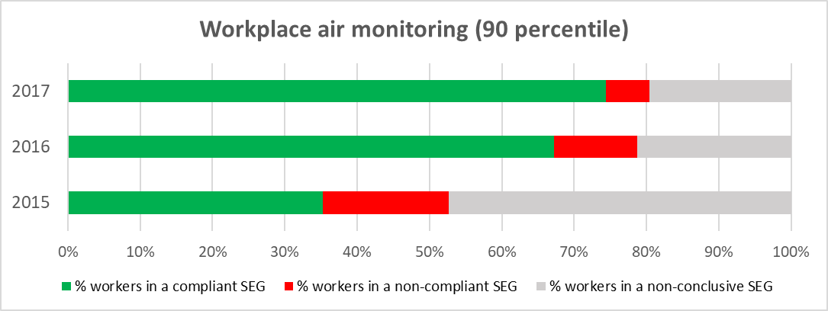
OCdAir Reporting: 90 percentile
90 percentile
Range [µg/m³] | 2015 | 2016 | 2017
% workers in a compliant SEG | 35% | 67% | 74%
% workers in a non-compliant SEG | 17% | 12% | 6%
% workers in a non-conclusive SEG | 47% | 21% | 20%
workers above 0,25µg/m³ (= +/- 1µg/m³ inhalable) |  | 91% | 81%
74% is compliant with 4 µg/m³ respirable
Only 19% is compliant with 1µg/m³ inhalable

Slide 24
Cd in Air monitoring: Conclusion
OEL at 4µg/m³ respirable: ICdA guidance – SCOEL 2010
  Geometric mean: 4 % non-compliant
  90 percentile: 26 % non-compliant
OEL at 1µg/m³ inhalable (= +/- 0,25 µg/m³ respirable): from new SCOEL opinion
  Geometric mean: 47 % non-compliant
  90 percentile: 81 % non-compliant
ICdA target for limit values
  OEL: push for 2010 SCOEL opinion at 4 µg Cd/m³ respirable (in combination with bio-monitoring)
  For long term chronic effects: geometric mean is defendable (cumulated effect over 40y) but some countries follow EN 689

Slide 25

take 30 minutes for a
Coffee break

Slide 26
OCdBio
Observatory of Occupational Cadmium Bio-monitoring

Slide 27
OCdBio - Occupational Cadmium Bio-monitoring Observatory
  Since 2008, Cd bio-monitoring data is collected in the Cd industry in order to convince ourselves and authorities on:
  the efficiency of our risk management program
  the compliance of the current exposure levels with the OELs
It is interesting for ICdA members to compare their own data with aggregated data from the whole Cd using industry
A meaningful follow-up requires:
  A long-term involvement of the companies; currently 10 years follow-up!
  A strong coverage of EU industrial sites: in 2017 there were…
  36 EU sites participating with data on 3737 workers
  36 sites reporting CdU (3568 workers)
  28 sites reporting CdB (3064 workers)

Slide 28
Selected biomarkers of exposure
  Cadmium in blood – CdB:
    indicator of recent (and older) exposure
    Measurement: Cadmium in blood (µg Cd/L)
Cadmium in urine – CdU:
    Biomarker of the amount of Cd stored in the body and in particular in the kidney cortex where the first signs of Cd toxicity develop
    Representative for cumulative cadmium absorption in the body over past 20 years
    Normalized measurement: Cadmium in urine (µg Cd/g creatinine)
    If study Prof. Van Maele can demonstrate that Cd is threshold carcinogen based on CdU => CdU is indicator to show compliance.

Slide 29
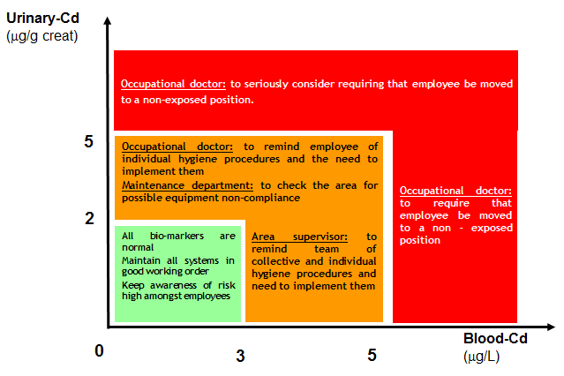
Using “exposure biomarkers” to conduct adequate advanced medical surveillance
(2013 ICdA Guidance)

Slide 30
OCdBio
Results of data collection of 2017 monitoring exercise

Slide 31
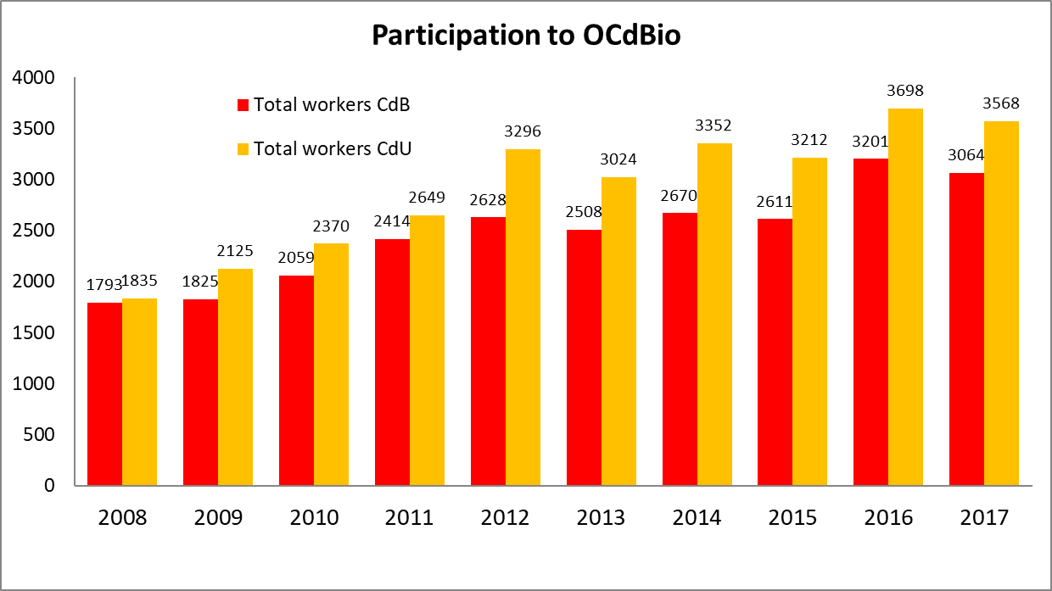
Number of reported workers
high response and increasing: 5 more plants reporting in 2017

Slide 32
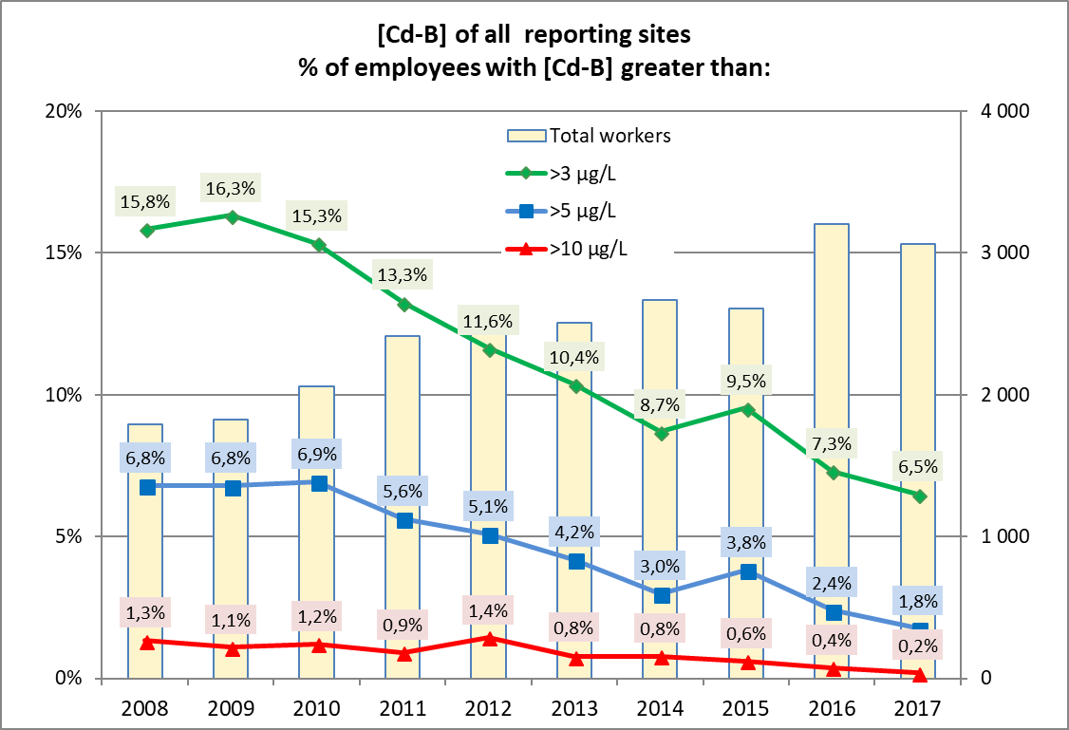
CdB distribution
- all sites in % -
After an unexpected increase in 2015, the decreasing trend for Cd uptake continues.
6,5% >3µg/l is too much (considering only 1,3% has CdU > 2): this will push CdU up!!!

Slide 33
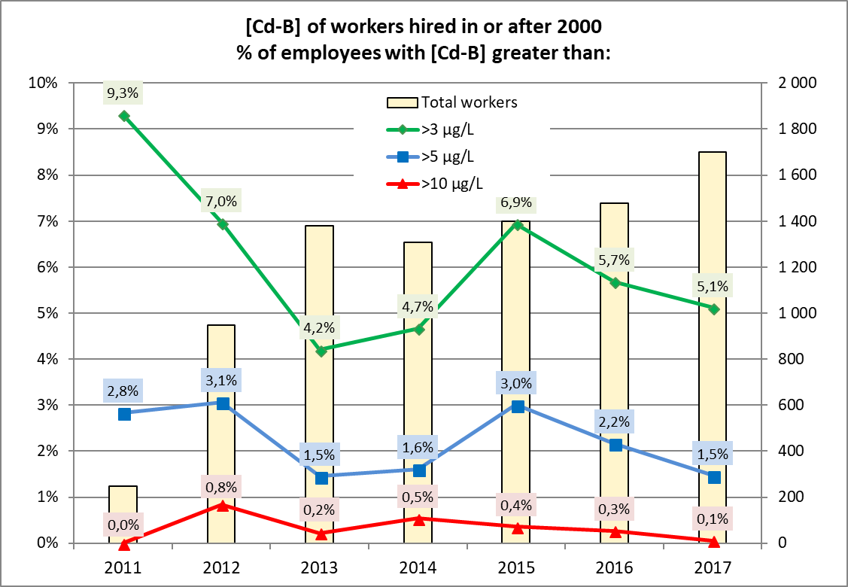
CdB distribution workers hired after 2000
- all sites in % -
Too much worker in this group have too high Cd exposure
Only 0,6% have CdU>5, so no excuse for so much workers with high CdB
Further attention needed!!!!

Slide 34
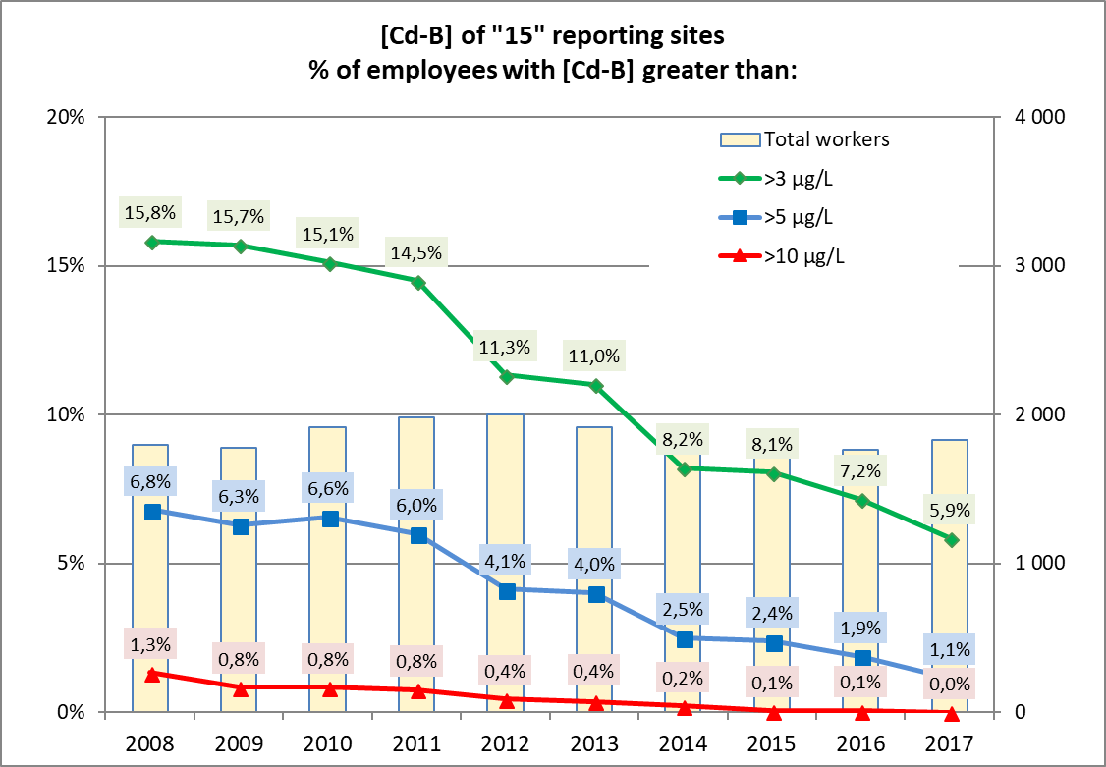
CdB distribution original “15”
Only 0,5% of these workers have CdU >5.
Higher CdB values mostly linked with recent exposure and not to historic burden.

Slide 35
Cd in Blood: conclusion
Good progress was made: Exposure of workers was reduced in 2017
But…
  Still too many workers have too high level of exposure to keep (or bring) them below the target of 2µg Cd/g creatinine.
  Comparison with CdU data shows that increased CdB values are most often not related to high historic burden => sign of too high recent exposure
Future compliance with BLV of 2µg Cd/g creatinine?
  We should keep all workers below 5 µg Cd/L in blood
  We should strive not to have more then 1% workers above 3 µg Cd/L in blood (max.1% excused because of historic cadmium body burden)
Continued efforts are required to reduce exposure and comply with the new upcoming exposures limits.

Slide 36
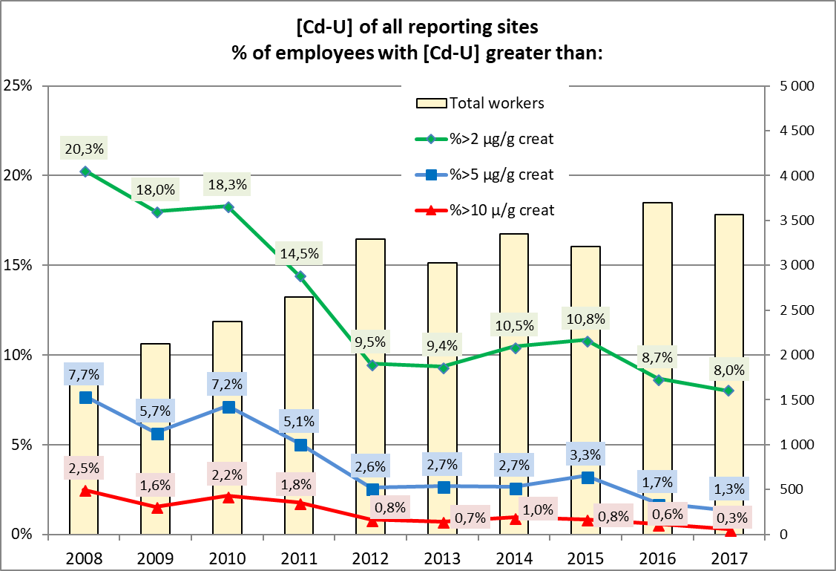
CdU distribution
- all sites in % -
2020 forecast: 6% will be above 2µg/g creatinine

Slide 37
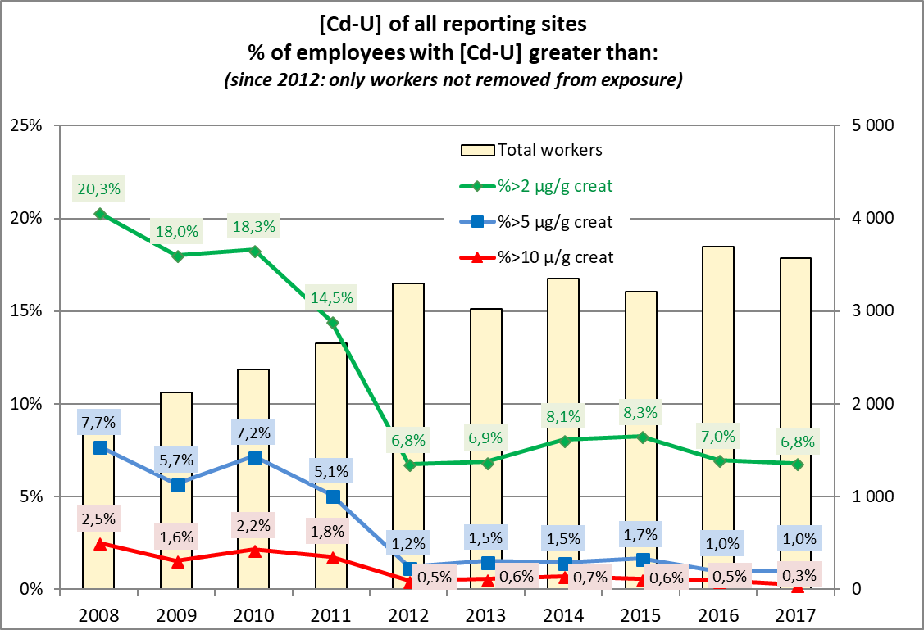
CdU distribution
- all sites in % - (removed workers excluded)
Decreasing trend for Cd not sufficient.
5% will exceed 2µg Cd/g creat by 2020.
We need to set tougher criteria

Slide 38
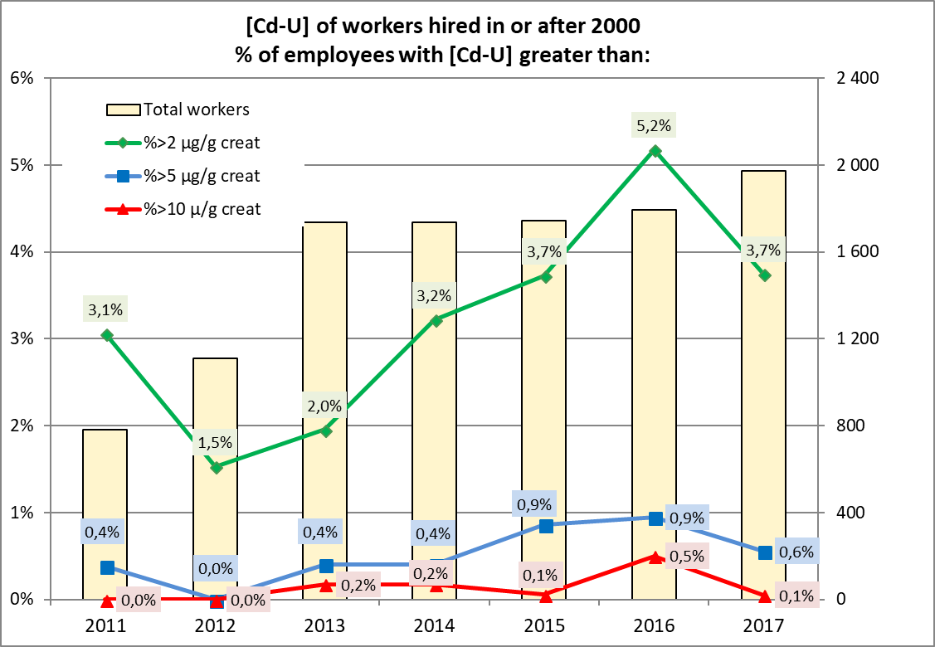
CdU distribution
- all sites in % - workers hired after 2000
Increasing trend for Cd finally reversed.
But: too much people in this group have too high urinary Cd.

Slide 39
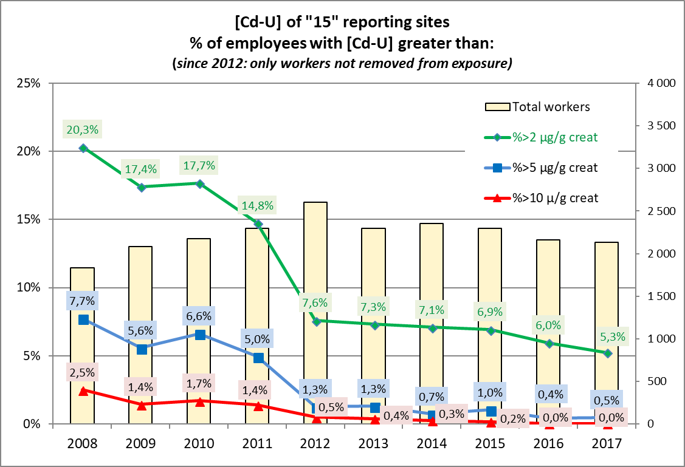
CdU distribution
- original “15” sites in % - (removed workers excluded)
Decreasing trend for Cd likely not sufficient.
2020 CdU target 98% < 2µg/g creat.???
Optimistic forecast: 96%!!!

Slide 40
Forecast of CdU by 2020
Workers hired in or after 2000
  Optimistic forecast: 2% > 2µg Cd/g creatinine
All workers
  Optimistic forecast: 5% > 2µg Cd/g creatinine
Positive elements:
  Effect of reduced exposure as reflected by lower CdB values translates in a reduction of CdU values (but further efforts are needed at some places)
  The group with high cadmium burden (>5µg) is disappearing from the workplace (retirement, removed from exposure, lower exposure).
  Some plants should remind the medical doctor that removal from a workplace with cadmium exposure is recommended for workers with CdU > 5µg/g creat.
  Historic Cadmium burden of some workers is too high to bring them below 2µg Cd/g creat. by 2020, but this number is going down due to retirement.

Slide 41
Conclusion
CdB
  exposure to Cd is back under control.
  Over the past 10 years, our industry has consistently improved the workplace exposure of its workers…and these efforts should continue
  Plants should aim not to have workers with CdB > 3µg/L in order to approach the CdU < 2µg/g in 2020.
CdU:
  Situation continued to improve in 2017
  Excellent progress: Number of workers above 2µg/g creatinine has dropped with 75% since 2008.
  5% of workers is expected to be above 2µg/g creatinine in 2020
  The following question is raised: should we lower the action level for CdB and CdU of the 2013 ICdA Guidance? (see later)

Slide 42

Now it is time for the
Lunch buffet

Slide 43
Status of EU COM proposed amendment of the CMD setting an OEL for cadmium and compounds at 1µg Cd/m³ inhalable
History of the amendment:
SCOEL - Impact Assesment - WPC/ACSH-COM
P. de Metz

Slide 44
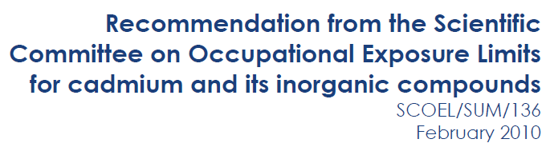
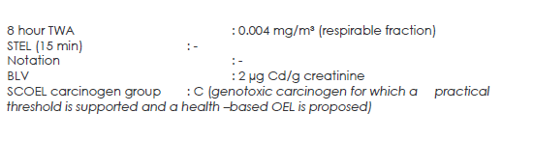
Scientific advise from SCOEL on EU cadmium exposure limits (1)
B
B
These values (OEL and BLV) are taken forward in the ICdA 2013 Guidance

Slide 45
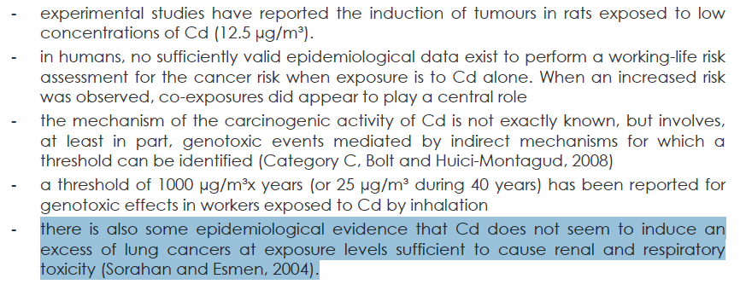
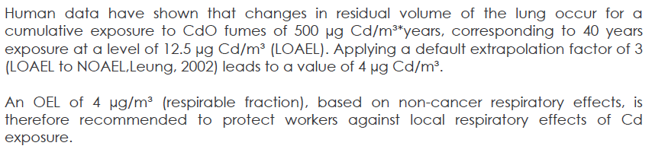
Scientific advise from SCOEL on EU cadmium exposure limits (2)
2µg/g creat (CdU): protective against systemic effect of Cd exposure (kidney, bone)
4µg/m3 (respirable) : protective against local respiratory effects of Cd exposure

Slide 46
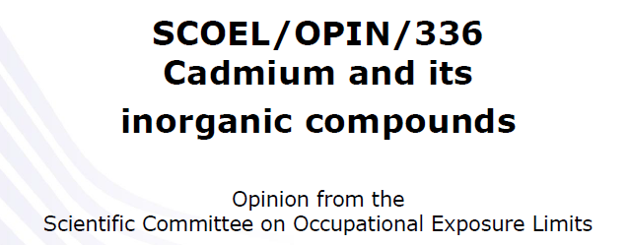
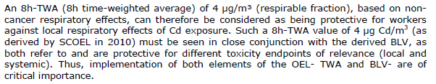
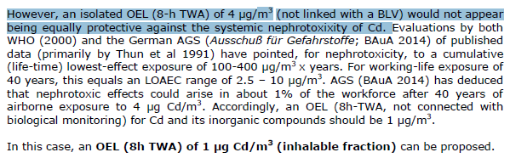
Scientific advise from SCOEL on EU cadmium exposure limits (3)
New SCOEL Opinion of 08/02/2017
This value of 1µg/m3 is NOT to protect local (lung cancer) BUT for systemic (kidney…) effects!

Slide 47
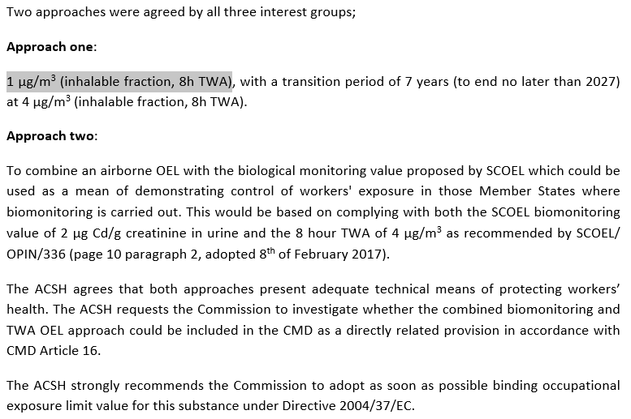
EU cadmium exposure limits
WPC (Working Party on Chemicals) compromise approved in ACSH (Advisory Ctee on Safety and Health at work – March 2017)
TWO APPROACHES:
Approach ONE: based on new SCOEL opinion
Approach TWO: based on old SCOEL recommendation

Slide 48
EU cadmium exposure limits
Looking at OCdAir 5 reporting
  1µg/m³ inhalable will be very tough/impossible for many plants (50-80% non compliant)
  4µg/m³ respirable should be possible but efforts are required in a number of places.

Slide 49
Impact assessment
  Commission asked consultant not to consider biomonitoring
  Below 10µg/m³ inhalable, cost to industry sharply increases without much further reduction in health cost.
  At 1µg/m³ inhalable, an estimated 8 plants would close/move out of Europe.

Slide 50
Discussions at WPC
Final meeting of WPC (Working Party on Chemicals)
  Approach 2 with bio-monitoring was rejected by COM because “legally challenging”.
  Employers delegation disagreed with this conclusion.
  In its final Impact assessment document, the COM stated that the decision was taken by consensus of employers and employees!!!!
  On April 5, the Commission submitted the amendment.

Slide 51
Legislative process
Co-decission by Council and Parliament
  Both the Council and EP have to approve the amendment
    Further amendments are possible
    Council and EP must agree on all additional amendments
    Approval by qualified majority (2/3) in Council and EP
    Council is typically the stronger party in this process
  Intention to have this amendment voted before year end

Slide 52
Actions taken by ICdA and its members to avoid the setting of an unrealistic OEL
P. de Metz

Slide 53
Adress Council and EP
Position paper issued
Proposal for amendment issued
Contacts with council members and there national administration organized:
  Country champions take the lead in their country
  Support from UK, Fr, Cz and Fi
  Contacts with Es and It more difficult but expected there is possibility to find sympathy for our proposal: need to be convinced before Council meeting of July 6!
  Germany: supports COM proposal
  Poland: support a transition of 10 years
Parliament
  Positive meeting with rapporteur of EP commission: will very likely defend the ICdA amendment text. (we need some support from Unions!)
  We will try to have meetings with all the shadow rapporteurs

Slide 54
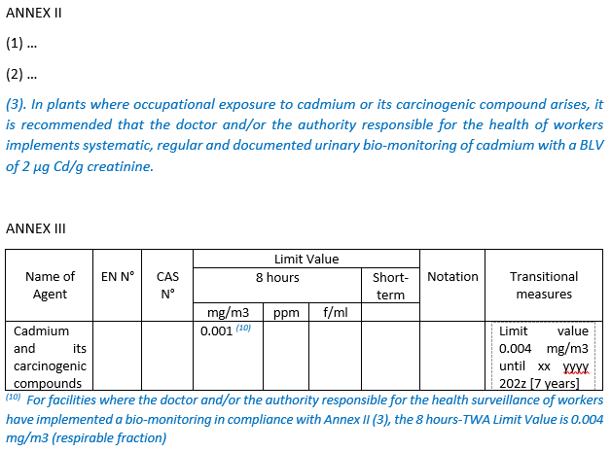
Amendment proposed by ICdA to Council and EP

Slide 55
Discussion
review of the ICdA Guidance document

Slide 56
Situation good but not excellent
OCdAIR shows:
  Reporting is not as extensive as OCdBIO
  Compliance with DNEL is weak (74% at 90percentile)
  Action: promote monitoring and reporting
OCdBIO shows:
  Progress has been steady
  Progress will be slower
  Progress could stall
  Action: assess ICdA guidance for fitness
The Guidance is an important reference document to which we refer in discussions with authorities!!!

Slide 57
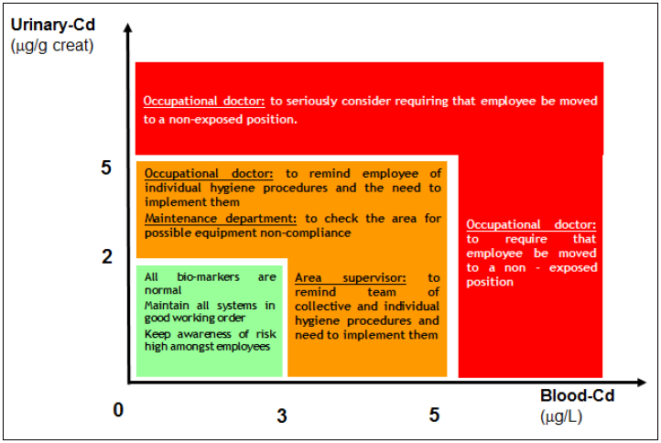
ICdA guidance document (2013) decision diagram_English

Slide 58
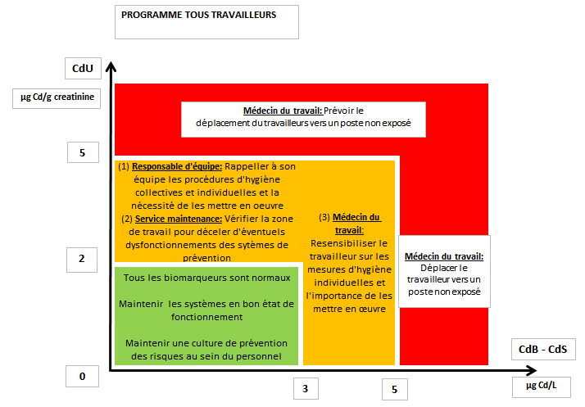
ICdA guidance document (2013) decision diagram_French

Slide 59
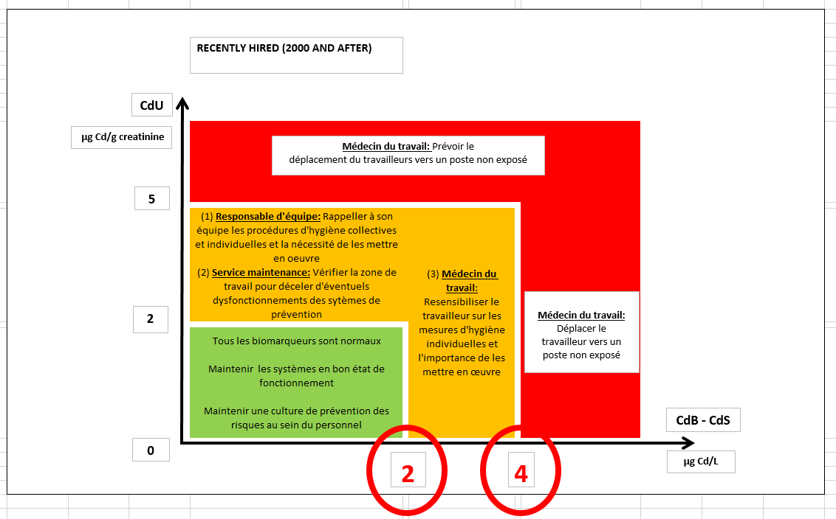
Proposal for new CdU action level
Reduced action levels for CdB:
  First action level: from 3 to 2
  Second action level: from 5 to 4
Expected benefit: better control over CdU increase above 2µg Cd/g creatinine

Slide 60
THE END
A.o.b.
Closing of the meeting

