Slide 1
Workplace air monitoring for cadmium
ICdA webinar
10 March 2023

Slide 2
STATEMENT OF COMPLIANCE
The purpose of the meeting is to address, under the applicable confidentiality rules, issues concerning Cadmium and Cadmium compounds producers and importers and more particularly their obligations under the several regulations.
The minutes kept during the meeting will have to reflect all significant matters discussed during the meeting.
No discussions will be held, formally or informally, during specified meeting times or otherwise, involving, directly or indirectly, express or implicit agreements or understandings related to: (a) any company’s price; (b) any company’s terms or conditions of sale; (c) any company’s production or sales levels; (d) any company’s wages or salaries; (e) the division or allocation of customers or geographic markets; or (f) customer or suppliers boycotts; or (g) any disclosure of information which may affect applicable rules on Competition Law.
The International Cadmium Association (ICdA), as a group will make no recommendations of any kind and will not try to reach any agreements or understandings with respect to an individual company’s prices, terms or conditions of sale, production or sales levels, wages, salaries, customers or suppliers.

Slide 3

Sharing best practice
Regulation on workplace exposure to cadmium
How to perform workplace monitoring
Compliance checking
Equipment for workplace air sampling

Slide 4
Regulation on workplace exposure to cadmium

Slide 5
Regulation on workplace air
EU minimum requirement:
  Carcinogens and Mutagens Directive 2019/983
  Limit value 0,004 mg/m³ until 11 July 2027
    Inhalable fraction.
    Respirable fraction in those Member States that implement, on the date of the entry into force of this Directive, a biomonitoring system with a biological limit value not exceeding 0,002 mg Cd/g creatinine in urine.
  Limit value 0,001 mg/m³, inhalable fraction, from 11 July 2027
    Discussions ongoing at the Advisory Committee for safety and health at the workplace whether to propose to the EU Commission a combination of an air limit value (OEL) and a biologic limit value (BLV)

Slide 6
Overview of implemented limit values for occupational exposure to Cd
Country | Respirable | Inhalable | Transition value? | biological limit value
BE | 0,002mg/m³ Resp | 0,010mg/m³ Inh |  | none
BG |  | 0,004mg/m³ Inh | 0,001mg/m³ Inh (2027) | none
CZ | 0,002mg/m³ Resp | 0,010mg/m³ Inh |  | 0,002 mg Cd/g creat. 0,005mg/L blood
DE | 0,002mg/m³ Resp | 0,002mg/m³ Inh (kidney effects) | not decided yet | none
ESP | 0,002mg/m³ Resp | 0,004mg/m³ Inh | 0,001mg/m³ Inh (2027) | 0,002 mg Cd/g creat.
FI | 0,004mg/m³ Resp |  |  | biological action limit value for cadmium in blood 50 nmol/l and urine 20 nmol/l (corresponds to 5µg Cd/L blood and 2µg Cd/g creatinine)
FR |  | 0,004mg/m³ Inh | 0,001mg/m³ Inh (2027)
 | 0,004mg/m³ Resp |  |  | 0,002 mg Cd/g creat.
IT |  | 0,004mg/m³ Inh | 0,001mg/m³ Inh (2027) | none
NL | 0,004mg/m³ (Resp.?) |  | 0,001mg/m³ Inh (2027) likely but not decided yet. | 0,002 mg Cd/g creat. Recommended
NO | 0,001mg/m³ Resp |  |  | none
PL |  | 0,004mg/m³ Inh | 0,001mg/m³ Inh (2027) | 0,005 mg Cd/g creat. And 5µg Cd/l blood
SE |  | 4 ug/m3 (inhalable) (AFS 2020:6) | 0,001mg/m³ Inh (2027-07-11 )(AFS 2020:6) | Cadmium in blood (AFS 2019:3 §59-62) >75 nmol/l : Suspension from Cd work
Australia |  | 0,010mg/m³ Inh
Canada (BC) | 0,002mg/m³ Resp | 0,010mg/m³ Inh |  | none
Canada (Qu) |  | 0,025mg/m³ Inh |  | none
Switzerland |  | 0,004 mg/m³ Inh |  | none
China |  | 0,010mg/m³ Inh
Israel |  | 0,010mg/m³ Inh
Japan |  | 0,050mg/m³ Inh |  | 0,005 mg Cd/g creat. (not mandatory)
New Zealand | 0,002mg/m³ Resp | 0,010mg/m³ Inh |  | 0,002 mg Cd/g creat.
South Korea | 0,002mg/m³ Resp | 0,010mg/m³ Inh
UK | 0,030mg/m³ Resp (CdS&pigments) | 0,025 mg/m³ Inh (Cd &Cd comp.) | no indication | none
USA |  | 0,005mg/m³ Inh? (+action level at 0,0025mg/m³) |  | 0,003 mg Cd/g creat.

Slide 7
How to perform workplace monitoring
The basics
Setting up a SEG
Sampling time
Sampling with respiratory protection
Documentation of sampling
Number of samples
Frequency of sampling
Assessment of compliance

Slide 8
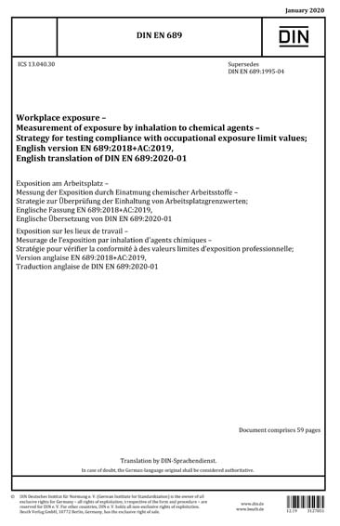
How to do workplace monitoring: the basics
Most national regulations refer to the workplace monitoring standard EN689
EN689:2018+C1:2019 = description of a statistical approach
  Specifies a strategy to perform representative measurements of exposure
  by inhalation to chemical agents in order to demonstrate the compliance
  with occupational exposure limit values (OELVs)
The sampling strategy principles are described in EN689
  Group your workers by similar exposure to cadmium: SEG
  Randomly select workers from each SEG for personal air monitoring
  Higher sampling frequency when exposure is more close to the limit value
  Statistical assessment of the sampling data to ensure compliance with
  the OEL
    Where exposure measurements on some workers of the SEG indicate that the OELVs
    are met (compliance), then it is considered that this is so for all workers in the SEG.

Slide 9

Setting up a SEG (1)
Definition of a Similar Exposure Group (SEG)
  Group of workers having the same general exposure profile for the chemical agent(s) being studied because of the similarity and frequency of the tasks performed, the materials and processes with which they work, and the similarity of the way they perform the task.
How to set up a SEG
  Start with an estimation of potential exposures of workers concerned,
  taking particular account of tasks with high exposures
  The possible sources of information include
    earlier measurements,
    measurements from comparable installations or work processes,
    reliable calculations based upon relevant quantitative data, and
    exposure modelling.

Slide 10

Setting up a SEG (2)
The SEG shall be constituted with information on the nature, level and duration of the tasks performed in the working shifts throughout the year.
This requires occupational hygiene expertise, and the information most often includes:
the job classification of the company, as a useful starting point,
the inventory of tasks within a job,
the task specific exposure nature and the estimation of the potential exposure
level, (see above) and if possible combined with the Operational Conditions (OC)
and Risk Management Measures (RMM) from a corresponding
REACH Exposure Scenario, and
the duration of the exposure within the shift and throughout the year,
determined by the frequency and period of the tasks.

Slide 11


Setting up a SEG (3)
Not a one-time exercise
  First trial often based on limited information.
  The more monitoring data collected, the better
  the understanding of the exposure.
  Attribution of workers to a SEG can change
  when equipment or procedures are changed.
Rule of tumb
  If an individual’s exposure measurement is less than half, or
  greater than twice the group average, then it is likely that the
  worker’s exposure is different from the SEG selected and should
  be reclassified into another SEG.
A SEG can be as small as 1 worker

Slide 12
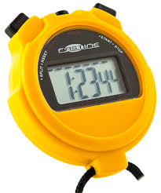
Sampling time
Starting point: OEL value for cadmium was defined as a 8h time average value
A sampling time of at least 6h, preferably 8h is recommended.
Short sampling times?
  Is a 15 minute or 2 h sampling representative for the average full shift exposure of the worker: Sampling times<2h are only allowed if they cover the full exposure time.
  Shorter sampling periods can be applied when exposure is know to be limited to a certain time frame (a location) and the result is mathematically time-averaged with a zero exposure during the rest of the shift.
    If exposure to Cd is only present for 2h and only these 2h are monitored as representative for an 8h shift, the monitoring result will overestimate the full 8h shift exposure with a factor 4!!!
  With a limit value of 1µg/m³, the amount of Cd captured is very small. The shorter the sampling time, the less Cd is collected and might fall below DL.
    Assuming a DL of 0,1µm analytical detection limit, a 2L/min sampling flow and an 2h sampling time results, the DL of 0,4µg/m³ which is often insufficient to demonstrate compliance!

Slide 13
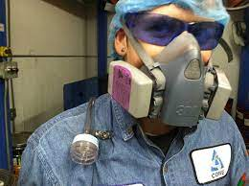
Sampling and respiratory protection
When respiratory equipment (PPE) is used, the air sampling
shall be done outside of this equipment
What to do when PPE is only used during a part of the shift?
  Several strategies are possible?
    Sampling only when wearing PPE (assuming exposure is << OEL at other moments)
    Sampling only when not wearing PPE (assuming PPE is 100% protective)
    Apply separate sampling when wearing/not wearing PPE and calculate average over the shift
Same remarque as before on accuracy and detection limit when applying short sampling times

Slide 14

Documentation of sampling (1)
For each sample, the appraiser shall obtain the following relevant information for the future interpretation of the results of exposure measurements:
identification of the SEG and of the workers;
description of the workplace;
chemical agents relevant for the activity;
work tasks normally performed;
daily working hours and the duration of exposure to chemical agents considered;
risk management measures such as engineering control, PPE, work organization, etc.;
relevant environmental conditions at the workplace (temperature, wind, relative humidity, …);
presence of other activities, incidents, etc.;
identification of technical sampling equipment used

Slide 15

Documentation of sampling (2)
To be able to link deviating results with unusual activities or events it is important to ask the worker to report this.
Examples of events that deviate from the intended activities:
General info on sampling, such as time and sampling flow rate at start and end
of sampling, ambient conditions, use of PPE, etc.
Extra maintenance activities,
Installation shutdown or malfunction
Other product use dan usual
Hygiene issues: exhaust ventilation is not correctly or not at all working, spills at the work floor, …
Another temporary assignment was given during the shift (please specify)
Smoking during sampling: this will affect the result as tobacco contains cadmium.

Slide 16

Number of samples
The number of samples per SEG depends on the level of exposure
  For low exposure levels: at least 3 samples
  For higher exposure levels: 6 up to 10 samples
  It is better to have sampling done at different moments rather that all at once to reflect fluctuations over time and over different seasons.
For each periodic reassessments, at least three exposure measurements shall be collected per SEG.
  These results can be pooled with the earlier ones in order to test compliance and to determine the period before the next reassessment.

Slide 17
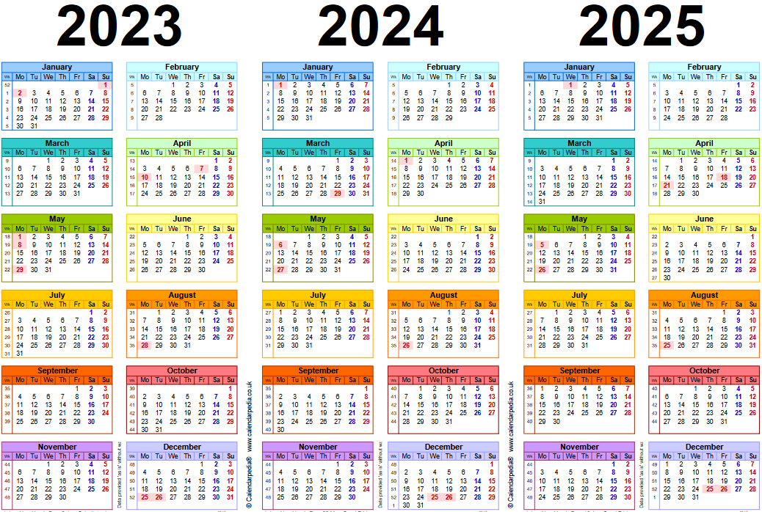
Frequency of sampling (EN689)
For periodic reassessments, at least three exposure measurements shall be collected per SEG.
These results can be pooled with the earlier ones in order to test compliance and to determine the period before the next reassessment.
If a compliance decision was reached by the screening test and conditions are unchanged, more measurements should be made to reach at least six including the original samples.
From the geometric mean value (GM),
the interval between sampling can be derived:
  36 months if GM < 0,1 OELV
  24 months if 0,10 OELV < GM < 0,25 OELV
  18 months if 0,25 OELV < GM < 0,50 OELV
  12 months if 0,50 OELV > GM

Slide 18

Compliance checking

Slide 19
Assessment of compliance
Rejection of outliers
  If no accidents, malfunctions or misuse can be identified, the sample shall not be excluded. Be attentive to such events while monitoring!
  Pooling of earlier samples only when exposure situation hasn’t changed!
Check if all samples belong to a same log-normal distribution
  The SEG you have designed might not be as homogeneous as you thought.
Air quality is measured without PPE
  When result is >OEL value, use of respiratory equipment and its protection factor shall be considered to assess the actual workers exposure.
  When PPE is needed:
    Assess potential sources of cadmium emissions to air and analyse how to remediate.
    Apply PPE with appropriate protection factor: [concentration measured]/[protection factor] < OEL
  Ultimate target = compliance without use of PPE

Slide 20
Screening test or full statistical test
The screening test
  Requires 3 to 5 exposure measurements for each SEG
  Compliance check
Compliance if all results are below
  0,10 OELV for a set of three exposure measurements or,
  0,15 OELV for a set of four exposure measurements or,
  0,20 OELV for a set of five exposure measurements
Non-compliance if one of the results under a) is greater than the OELV
Full statistical assessment
  If none of the conditions under a) are met but all values are <OEL, additional exposure measurements shall be carried out in order to apply a full statistical assessment.
  The test shall measure, with at least 70 % confidence, whether less than 5 % of exposures in the SEG exceed the OELV.
  Such assessment requires at least 6 samples

Slide 21
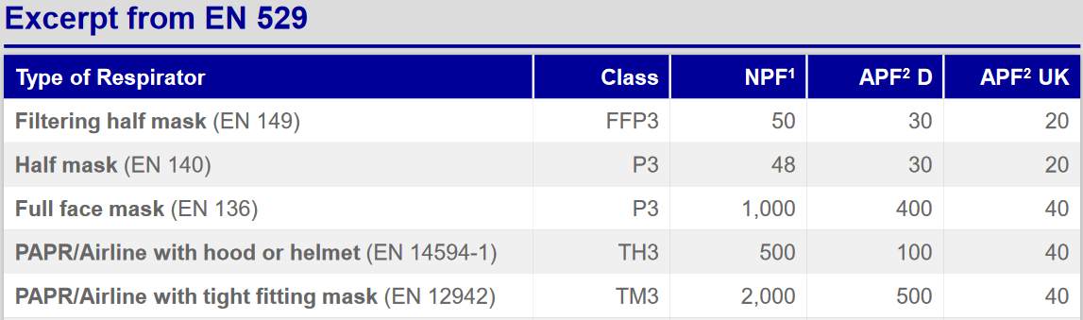
Corrections for respiratory protection
Apply the assigned protection factor (APF)
APF might be different from country to country

Slide 22
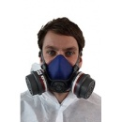
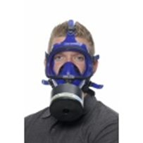
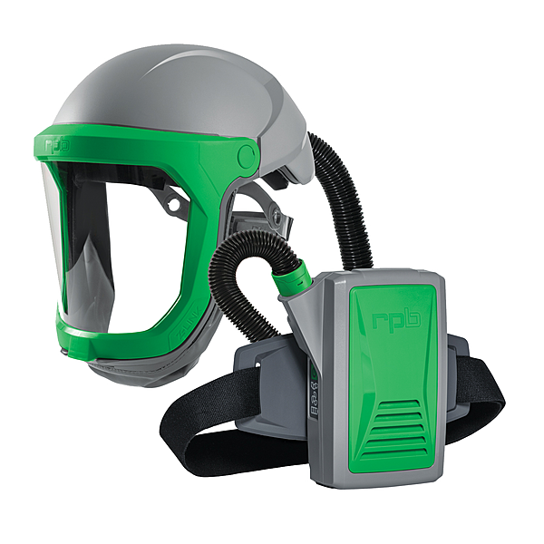
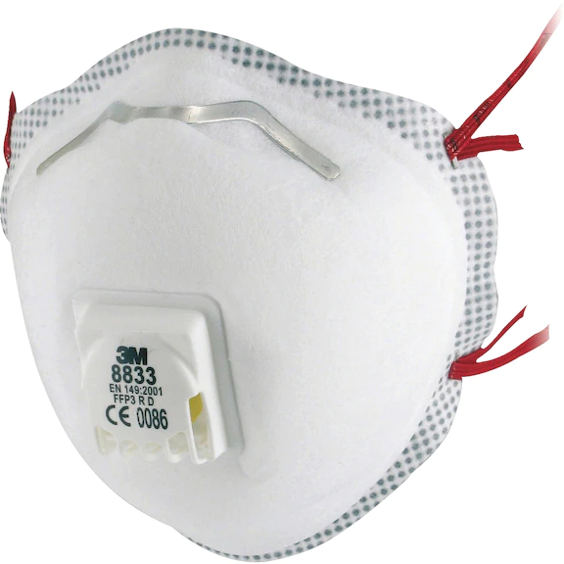
Filtering half mask EN140
Half mask
Full face mask
Powered Air Respirators (PAPR)

Slide 23
Equipment for workplace air sampling
Sampling techniques
Air sampling: which air fraction
Sampling equipment
Sampling heads
Sampling head filter manipulation
Calibration
Installing the equipment
Sample analysis

Slide 24
Sampling techniques
Static sampling
  For identifying sources of airborne cadmium at the workplace
  Easier to execute
  Can be a first step in setting up personal sampling
  This technique will not be covered in this session
Personal sampling
  More representative than static sampling for assessment of workers exposure
  Requires reasonably good knowledge of exposure to select representative workers

Slide 25
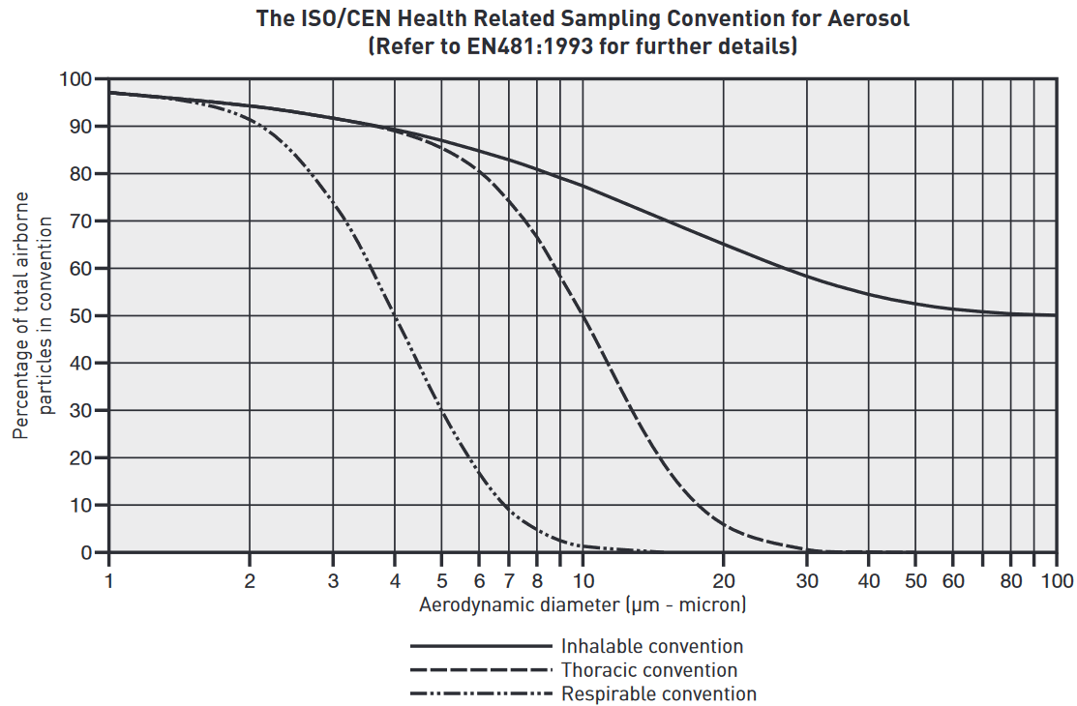
Air sampling: which fraction?
Inhalable fraction
  Airborne particles that can penetrate the nose and mouth and ends up in the gastric tract
  50 percentile at 100µm particle size
  Fraction proposed by the EU Commission
The thoracic fraction
  Fraction of inhalable particles that can penetrate the bronchial region
  50 percentile at 10µm particle size
Respirable fraction
  Fraction that penetrates into the alveoli
  50 percentile at 4µm particle size
  Fraction proposed by the ICdA (only when combined with biomonitoring)

Slide 26
Sampling equipment
Filter(sampler) head and filters
Air sampler pump
Calibrator

Slide 27
Sampling heads
Cyclone head (Respirable fraction)
  Higgins-Dewell (HD) cyclone: mostly used in Europe
  Dorr Oliver (DO) cyclone: mostly used in USA
  The cyclone technique is sensitive to air speed: requires calibrated air pump for accurate sampling of the respirable fraction. Check instructions of the cyclone head for the required flow! Check flow before and after the sampling;
I.O.M sampling head (Inhalable fraction)
  Collection of inhalable dust on a filter.
  A multiDust polyurethane foam (PUF) discs can be inserted into the standard IOM cassette that retains the coarse particle while the respirable particles can pass and are captured on the filter. By analysing the PUF disk and the filter, the inhalable and respirable fractions can be measured simultaneously.
Conical Inhalable Sampler (C.I.S.)
  multi-fraction sampler that simultaneously collects the inhalable and respirable fractions
  Gravimetric analysis: higher detection limit, unsuitable for the low levels that are needed for cadmium monitoring.
Cascade impactors (PPI): Respicon sampler
  Allows simultaneous sampling of multiple fractions
  Gravimetric analysis: higher detection limit, unsuitable for the low levels that are needed for cadmium monitoring.

Slide 28
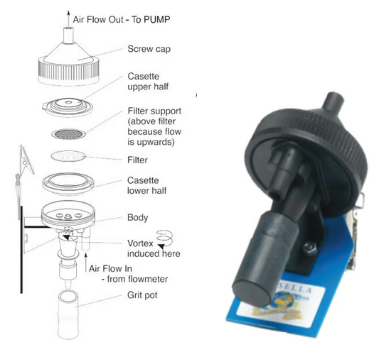
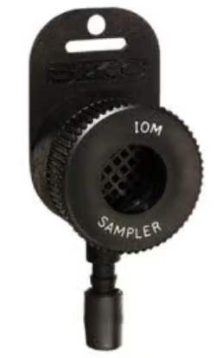
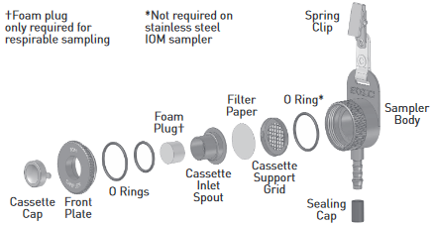
Sampling head
Cyclone sampler
for respirable fraction
I.O.M. sampler
for inhalable fraction or inhalable + respirable

Slide 29
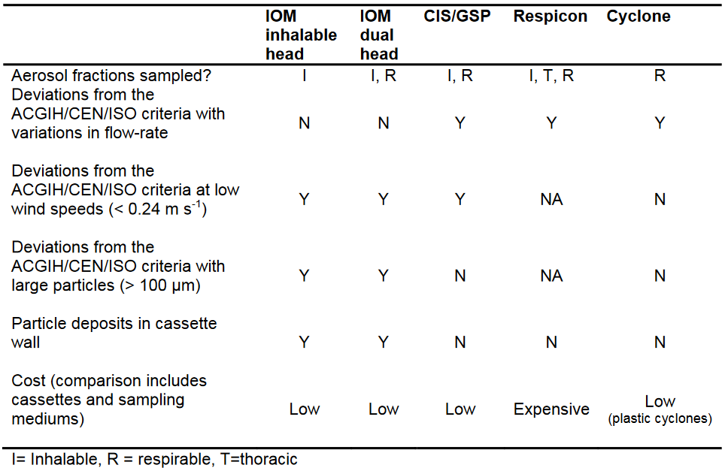
Comparison of sampling heads

Slide 30
Sampling head filter manipulation
Avoid contamination during installation/removal of filter and filter head
  Work in in a clean area:
    Do not manipulate the filter cassette at the workplace!
  Wear clean disposable gloves
  Remove the filter cassette and seal off.
  It is recommended that the lab also rinses the filter cassette to collected dust deposited on the walls
Recommended soluble filters:
    Mixed cellulose ester (MCE) membrane filters 0,8µm
    Polyurethane foam (PUF) for dual sampler.

Slide 31
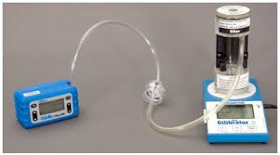
Calibration (1)
Calibration of the flow is required
  A constant flow during the test is required to be able to calculate the total of sampled volume. Flow at start and end should not deviate more than 5%
  The centrifugal sampler needs to be used with a precise and pre-defined flow
    For a cyclone sampler, an accurate setting of the flow is very important for the correct separation of the respirable fraction.
    Flow must stay within the margins indicated in the instructions of the sample head. If exceeded, the sample is invalid.
  The result of IOM sampler is within a broad range independent of the flow.
  For both sampler, the flow needs to be known to calculate the sample volume
    [Sample volume] = [L/min. pump flow] x [minutes sample time]
    [Concentration] = [captured Cd on filter]/[Sample volume]

Slide 32
Calibration (2)
After calibration, no need to insert a new filter
  Only needed when measuring total dust.
At the end of the sampling, have a quick re-check of the flow.
  Keep these re-checks as short as possible and do it in an area with no airborne cadmium.
Put the cap on the sampling head when not calibrating or sampling to avoid contamination.
Remind that a calibrator needs to be calibrated periodically as well!

Slide 33
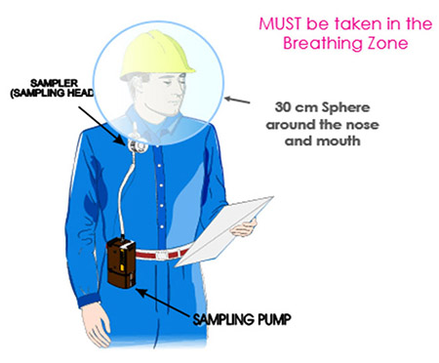
Installing the equipment
Air sampler pump can be attached to belt or put in a pouch
Sampler should be positioned within the breathing zone
The connecting tubing can present a hazard if left to flap around, so measures should be taken to protect the wearer by securing the tubing.
Check that the air tube is well positioned to avoid a kink as it will affect the air flow.
Position everything so it doesn’t hinder the worker during operations
Once the pump is mounted on the worker in a satisfactory way, remove the cassette cover and switch on the pump.
Note the exact time when starting and stopping the pump!
  Modern pumps have datalogging and will show the total volume sampled

Slide 34

Do not forget: Inform the worker!
It is very important to have an upfront briefing with the worker
Reason for this sampling
Points of attention during the sampling
Reporting of deviating work activities
or exposure conditions
When and how will he receive feedback

Slide 35
Sample analysis
Label your sample so it can be matched with the sample documentation
Gravimetric quantification: only for dust, no speciation possible.
  Not possible to discriminate: total sample weight, not the Cd weight.
  Higher level of quantification
  Susceptible to humidity
Chemical analysis
  A level of quantification (LOQ) of 0,02µg is achievable with ICP-MS
  Some labs use other analytical techniques and provide an LOQ of 1µg
    Too high for assessing exposure to cadmium
    Not possible to use the simplified screening test
    If you contract your workplace monitoring to and external company, negotiate a sufficiently low LOQ in you contract!
  It is recommended that the lab also rinses the filter cassette to collected dust deposited on the walls.

